Slide 1
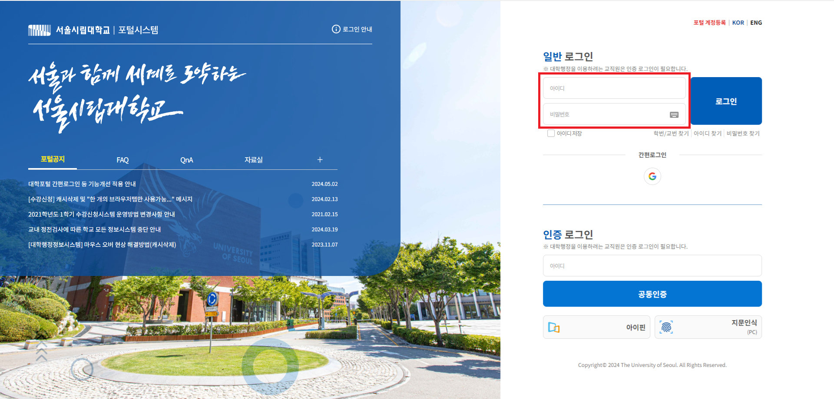
Guideline for WISE (대학행정정보) system
How to access WISE in portal
1. Log in to the UOS portal : http://portal.uos.ac.kr

Slide 2
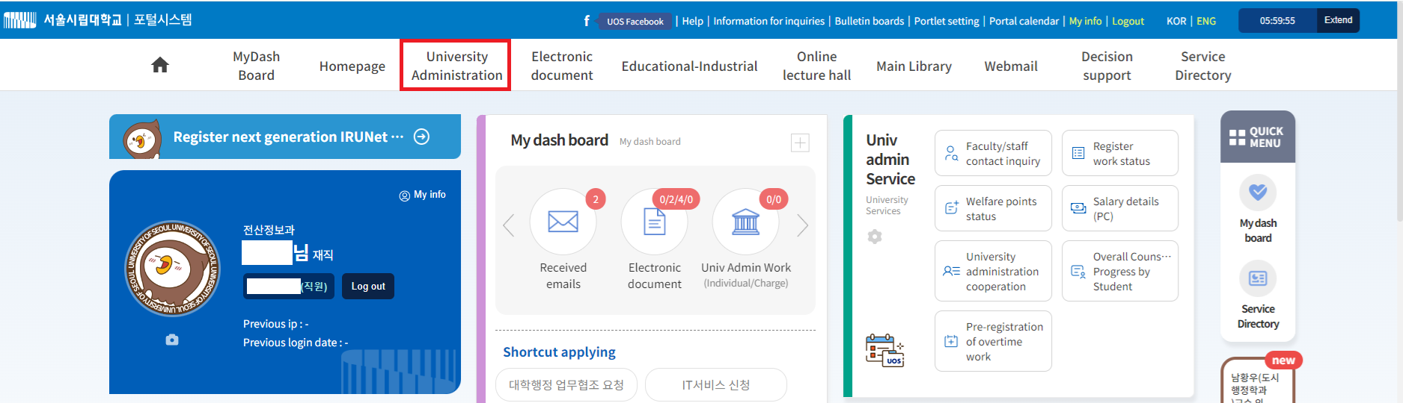
Guideline for WISE (대학행정정보) system
How to access WISE in portal
2. Choose “대학행정”, the 2nd menu.

