Slide 1
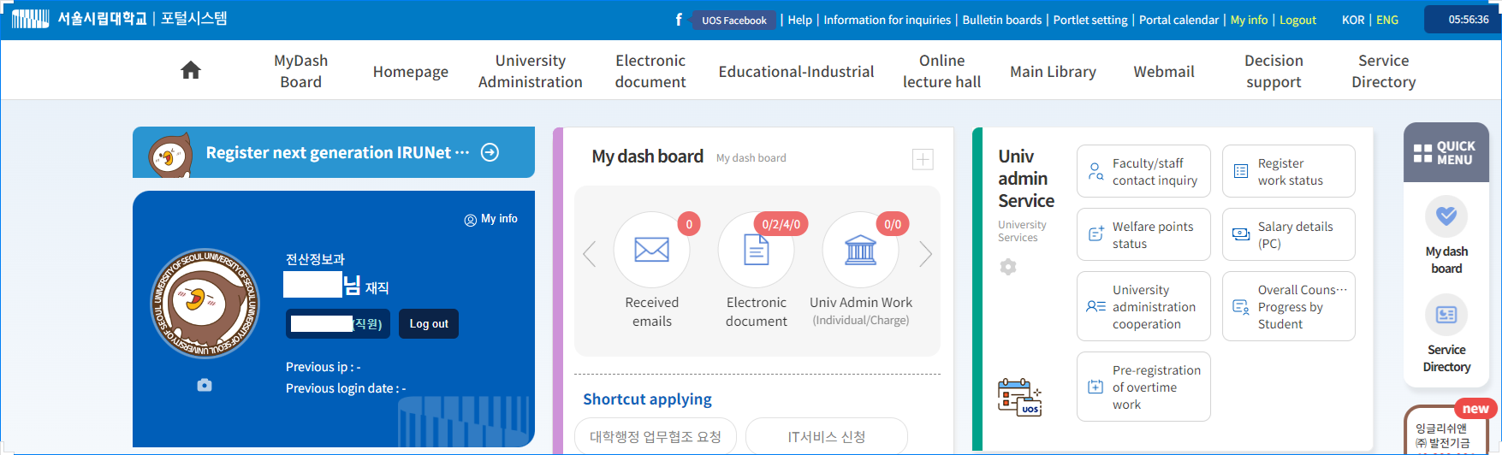
(직원)
How to change a UOS portal password
1. Log in to UOS portal and choose “마이페이지”.

Slide 2
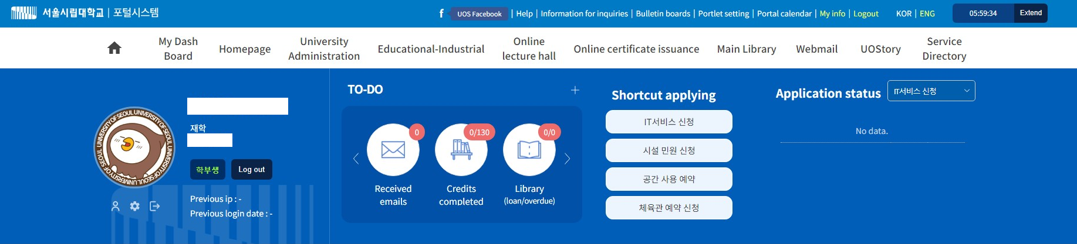
(학생)
How to change a UOS portal password
1. Log in to UOS portal and choose “마이페이지”.

Slide 3
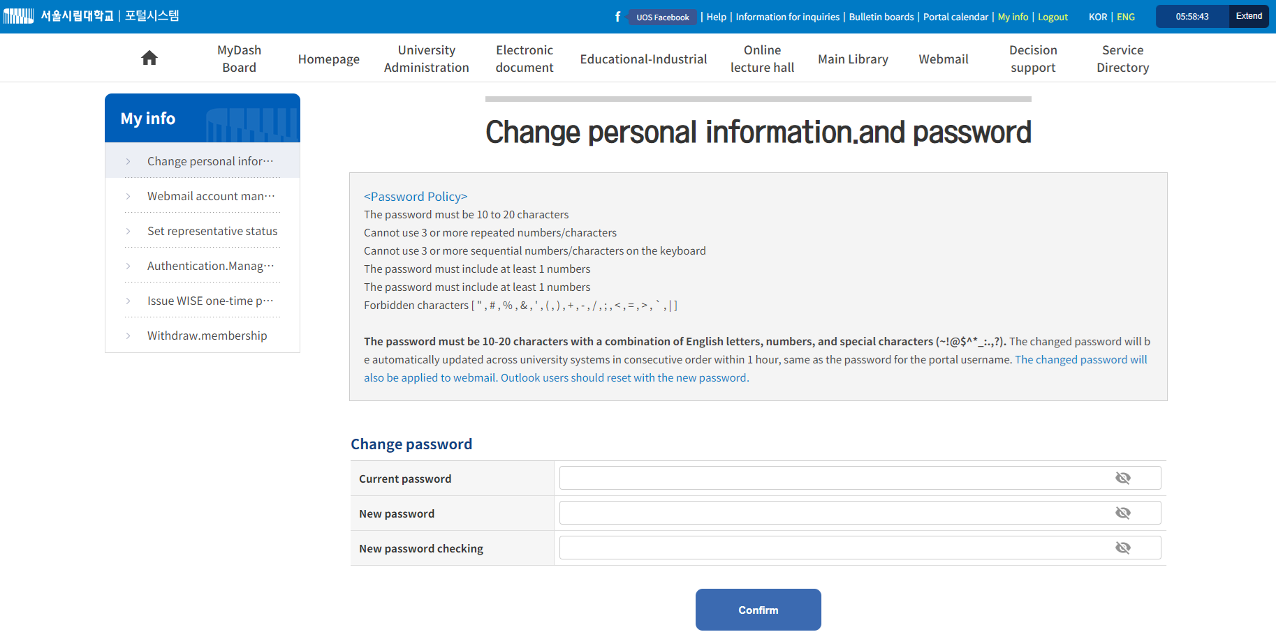
2. Change the password.
※A UOS portal password must be at least 10 characters long and should not exceed 20 characters and should contain numbers. The special characters allowed are: ~ ! @ $ ^ * _ { } …..

